Slide 1
Feature scaling
It is the most important data pre-processing step in machine learning Feature scaling is a method used to normalize the range of independent variables or features of data. In data processing, it is also known as data normalization and is generally performed during the data preprocessing step.
Feature scaling helps machine learning and deep learning algorithm train and converge faster .

Slide 2
Some of the algorithm where we use the concept of feature scaling are:
KNN
K means clustering
Deep learning based algorithm

Slide 3
Techniques of feature scaling
1.Normalization
2.Standardization

Slide 4
Techniques of feature scaling
1.Normalization :
It helps to scale down feature between 0 & 1
It is also called as min-max scaler.
It will help to change the values of numeric columns in the dataset to use a common scale. It is not necessary for all datasets in a model. It is required only when features of machine learning models have different ranges.
It can be calculated by following formula
Xn = (X - Xminimum) / ( Xmaximum - Xminimum)
Xn = Value of Normalization
Xmaximum = Maximum value of a feature
Xminimum = Minimum value of a feature

Slide 5

Techniques of feature scaling
2.standardization :
Standardization scaling is also known as Z-score normalization, in which values are centered around the mean with a unit standard deviation, which means the attribute becomes zero and the resultant distribution has a unit standard deviation

Slide 6
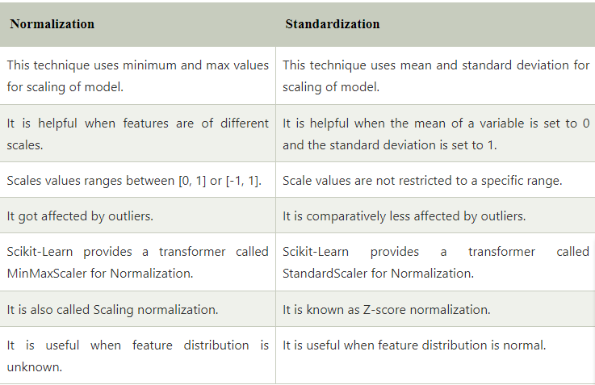
Difference between Normalization & standardization

